Slide 1


Study of the composition of neural networks for the automation of facial detection and recognition processes in the school environment
John Davi Dutra Canuto Pires
11/04/2024
Marcelo Costa Oliveira

Slide 2
Context
Background Information: Develop an end-to-end system that handles attendance records using neural networks for facial recognition in the surroundings and conditions of schools in a generalized way.
Problem Statement: Finding a model that can capture facial features well under adverse image conditions.
Significance: Decrease the additional workload for teachers and related staff and remove certain disruptions to the orderly implementation of normal teaching and administration.

Slide 3
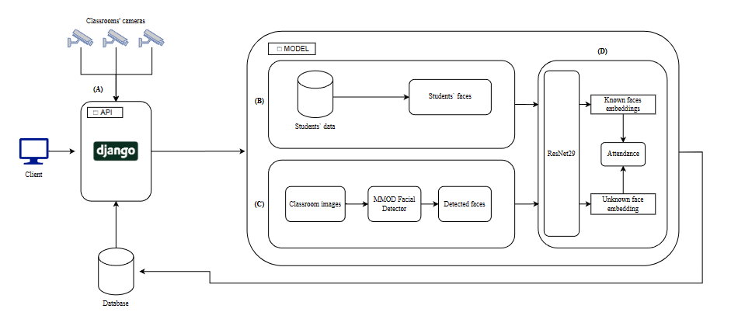
Context

Slide 4
Motivation
Personal Inspiration:
Firstly, I was tasked with solving the problem,
After this, I saw that the solution could transform the classroom into a cyber-physical environment.
Societal/Scientific Need: Improve the time management in classroom and pave the way for new ways of analysing students.
Expected Impact:
Giving the teacher more time to implement their pedagogical plan while ensuring full class time is utilized
Improving the performance of both the teacher and the student.

Slide 5
Objective
Research Question(s):
Can a face recognition model be quick and accurate simultaneously in this environment?
Is there a model that learns facial features well?
Hypothesis: Residual networks are optimal for these problems since they are lightweight and returns good results.
Research Goals:
Develop a reliable pipeline that can detect, recognize the students, and, in the future, analyse their emotions.
Verify which architecture is better at solving the problem of face recognition.

Slide 6
Relevance
Current State of the Field:
When discussing student frequency registration, techniques that use external devices such as mobile phones, ID cards, or fingerprints are always used.
In the light of face recognition, models such as FaceNet512, ArcFace, SphereFace, and SwinFace take the lead
The Research’s Contribution: Define and detail if a neural network method focusing on non-interaction can surpass manual methods.
Potential for Future Work: The study can propose a lightweight pipeline that can replace human action in the school environment and create expanding possibilities since the faces are recognized.

Slide 7
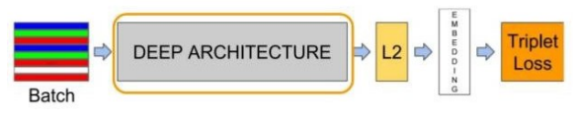
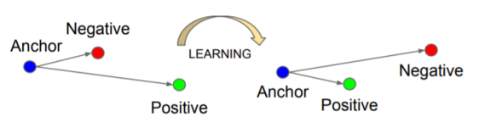
Brief Related Works
Key Literature:
D. Mery et al. (2019)[1] presented an alternative using mobile phone images and FaceNet as the main model, specifically, the ResNet version
E. Jose et al. (2019)[2] showed that a lightweight embedded system and cameras with a lower resolution, such as surveillance cameras, can be used to recognize faces in scholar environments
Gap in the Literature: The study aims to improve facial recognition using direct surveillance cameras for integration into the school's system, balancing speed and accuracy.

Slide 8
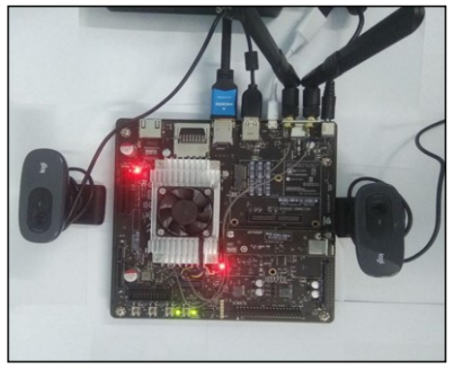
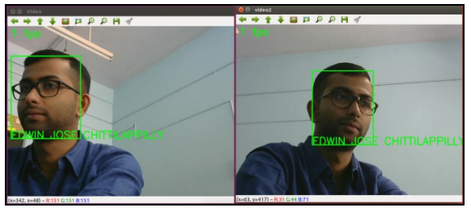
Brief Related Works

Slide 9
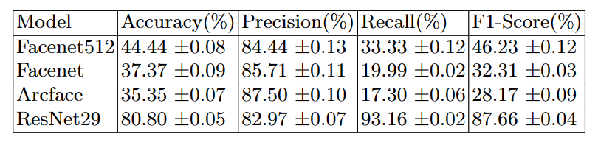
Preliminary Results
Data Collected/Experiments Conducted: The entire system uses ResNet as the main model and analyses 1 class through a semester using the surveillance cameras present in the classroom.
Findings:
Interpretation: The use of ResNet as the main model brought better results using low-quality images since it is light and quick performing the tuning

Slide 10
Preliminary Results
Data Collected/Experiments Conducted: The entire system uses ResNet as the main model and analyses 1 class through a semester using the surveillance cameras present in the classroom.
Findings:
Interpretation: The use of ResNet as the main model brought better results using low-quality images since it is light and quick performing the tuning

Slide 11
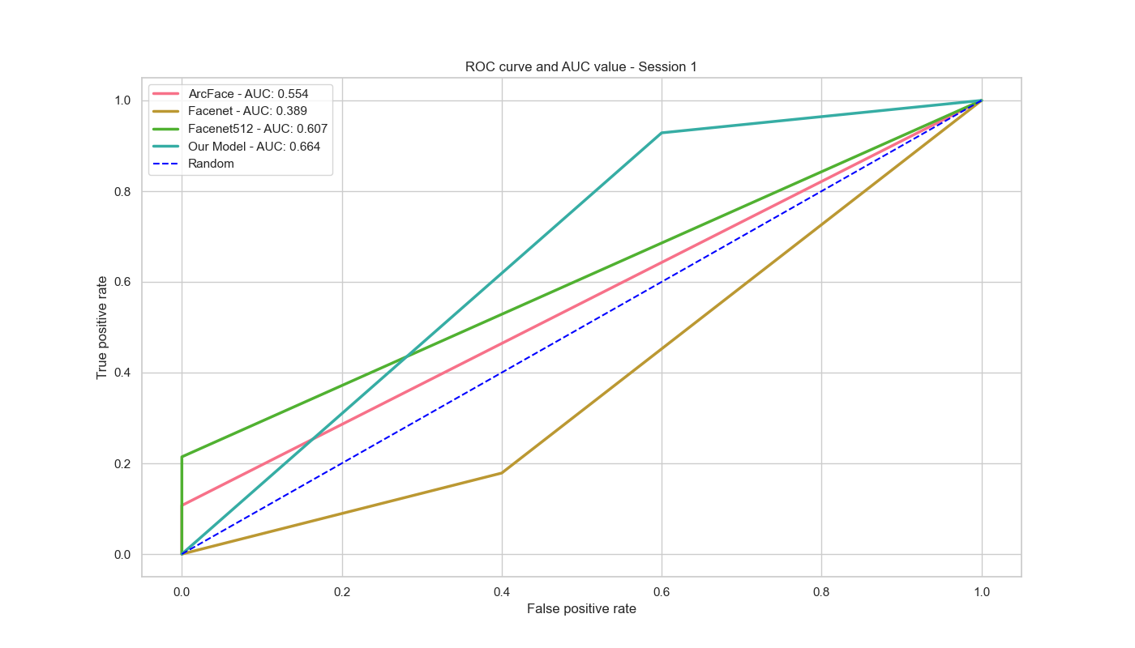
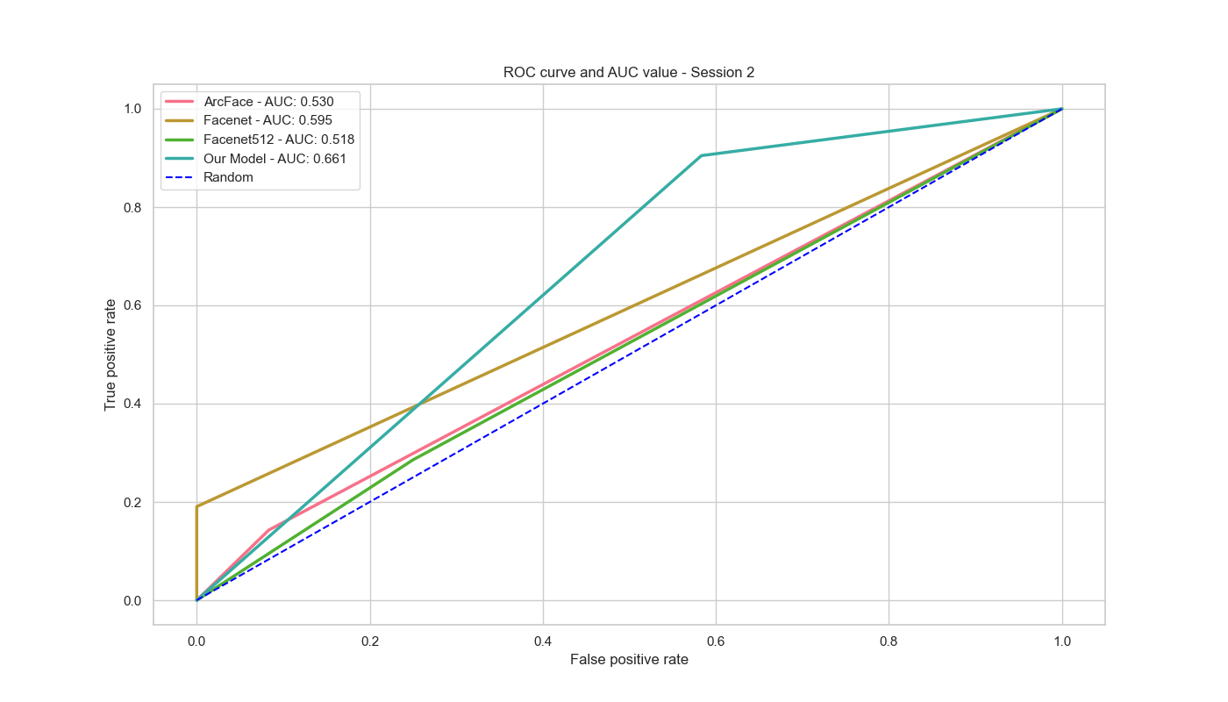
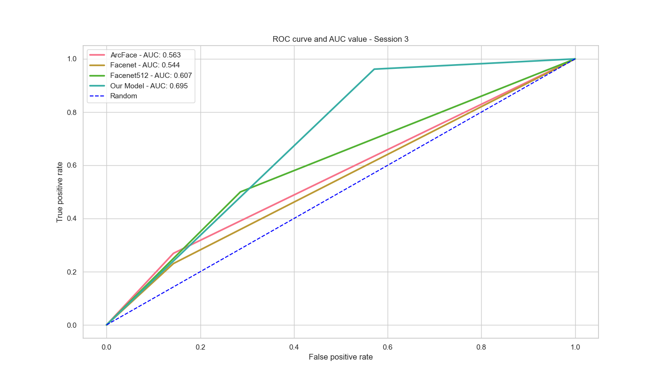
Preliminary Results

Slide 12
Conclusion and Future Directions
Summary: The main idea of the research is to develop an end-to-end system that uses a lightweight neural network model
Next Steps:
Study better models that fit the context, recognizing faces in low quality images
Analyse the addition of an emotion recognition model

Slide 13
References
[1] D. Mery, I. Mackenney and E. Villalobos, "Student Attendance System in Crowded Classrooms Using a Smartphone Camera," 2019 IEEE Winter Conference on Applications of Computer Vision (WACV), Waikoloa, HI, USA, 2019, pp. 857-866, doi: 10.1109/WACV.2019.00096
[2] E. Jose, G. M., M. T. P. Haridas and M. H. Supriya, "Face Recognition based Surveillance System Using FaceNet and MTCNN on Jetson TX2," 2019 5th International Conference on Advanced Computing & Communication Systems (ICACCS), Coimbatore, India, 2019, pp. 608-613, doi: 10.1109/ICACCS.2019.8728466

